Slide 1

Academic Project: WESP T3100/T3200
Maximilian Tichter & Marcel Rummens
Johannes Luther
IsarNet AG
DHBW Ravensburg, Campus Friedrichshafen
19.06.2018

Slide 2

AGENDA
Project Presentation
SCOPE
OID-CHALLENGE
PYTHON APPLICATION ARCHITECTURE
WESP-WEB
FUNDAMENTALS
RESULT

Slide 3
SCOPE
Fetching WiFi Client Status-Data
Right OIDs
to address corresponding MIB object via SNMP
Python-App
running on the Commandline
in the style of a Ping
DB
to save fetched WiFi-Status data
in the form of a Ping-Log
monitoring WiFi Client-Status data
connected to core application
Web-App
monitoring WESP Ping
providing evaluation charts
showing Live-Feed and statistics

Slide 4
FUNDAMENTALS
SNMP-Protocol & OIDs & Cisco WLC
SNMP Protocol
OID Object Navigator
Cisco 2500er Series WLC + Cisco Aironet APs
Used protocol for WLC access
Cisco Search-Engine for OID-Objects
Test Hardware (Development Environment)
Notes:
EasySNMP, GitWalk, Trap erwähnen

Slide 5
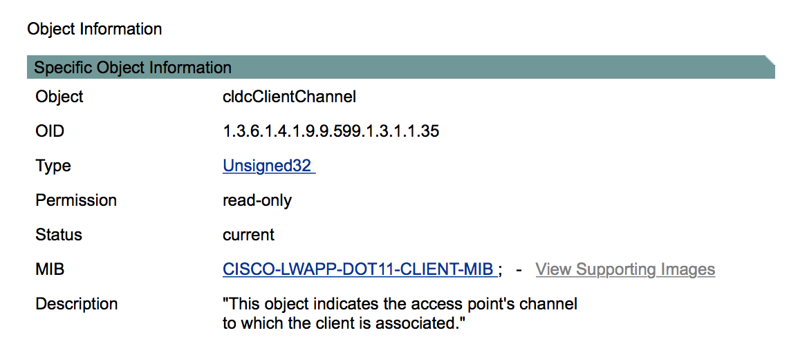
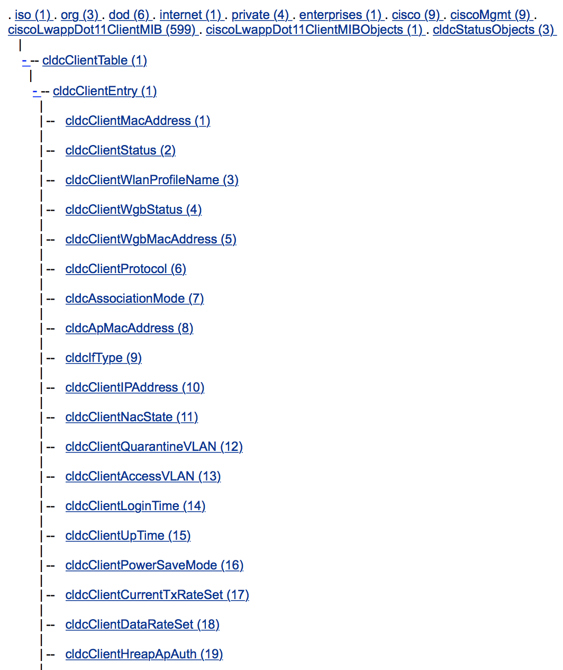
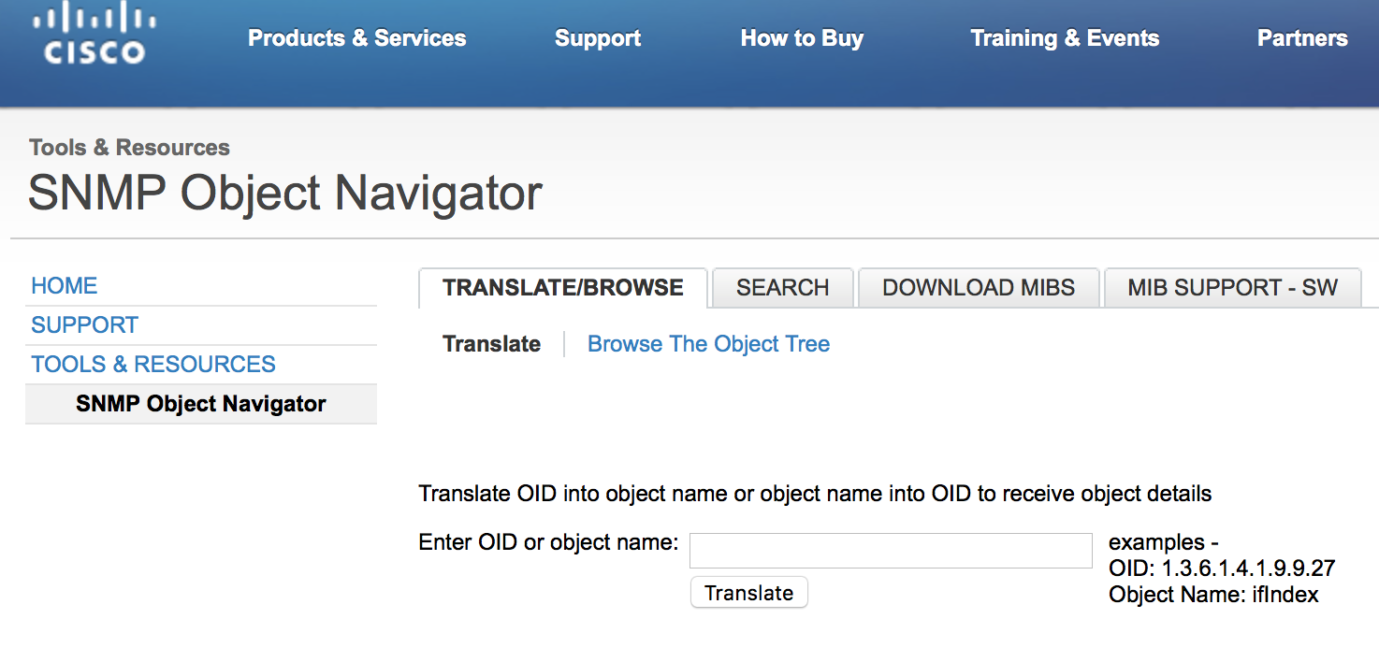
OID CHALLENGE
Finding the right OIDs in Cisco SNMP Object Navigator
WLC MIB Object-Tree
More than 100K OIDs
Similar named OIDs with different purposes
OIDs within different branches with same purpose
Often just one working
Node.js-Script “OID breaker” for automatic OID-Testing
BTW: Cisco Technical Support don‘t know their stuff either.

Slide 6
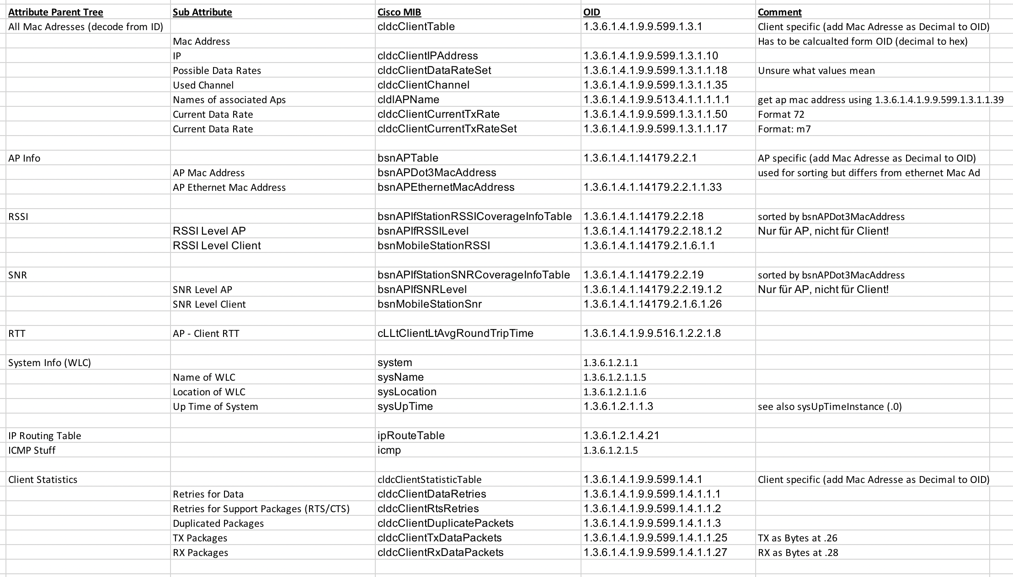

Slide 7
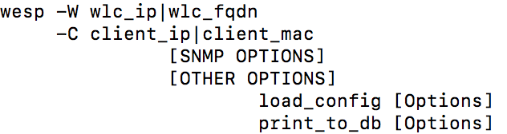

PYTHON APPLICATION ARCHITECTURE
Commandline Tool + Logging DB
1
1
EasySNMP
3-Step Extensibility
2
2
Package “Click”
Automatic Setup
Channel
Retries
AP-Name
RSSI
RX/TX packets
Ping
SNR
Client Data-Rate
3
3
mySQL Connector
Environment Adaptability

Slide 8
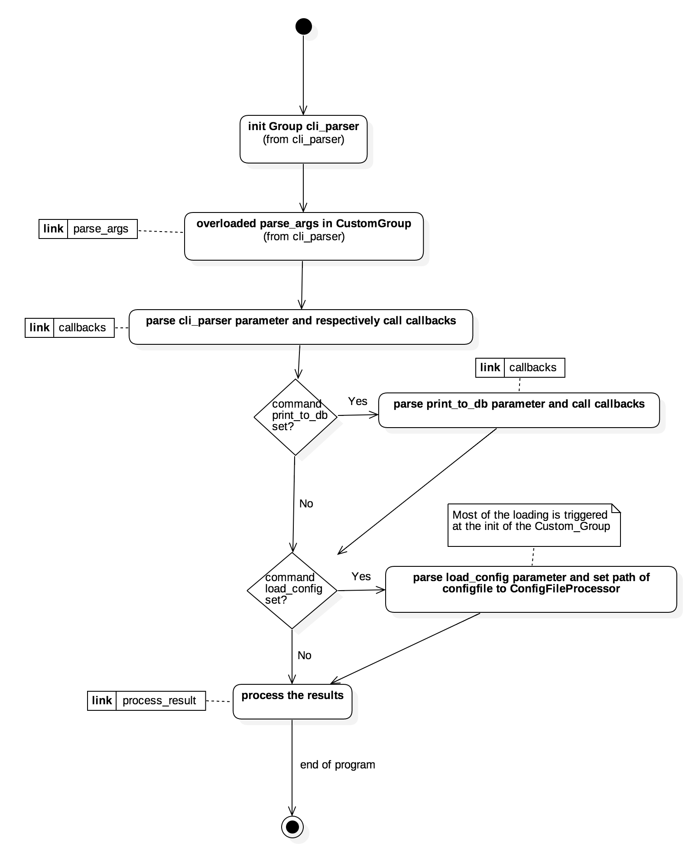
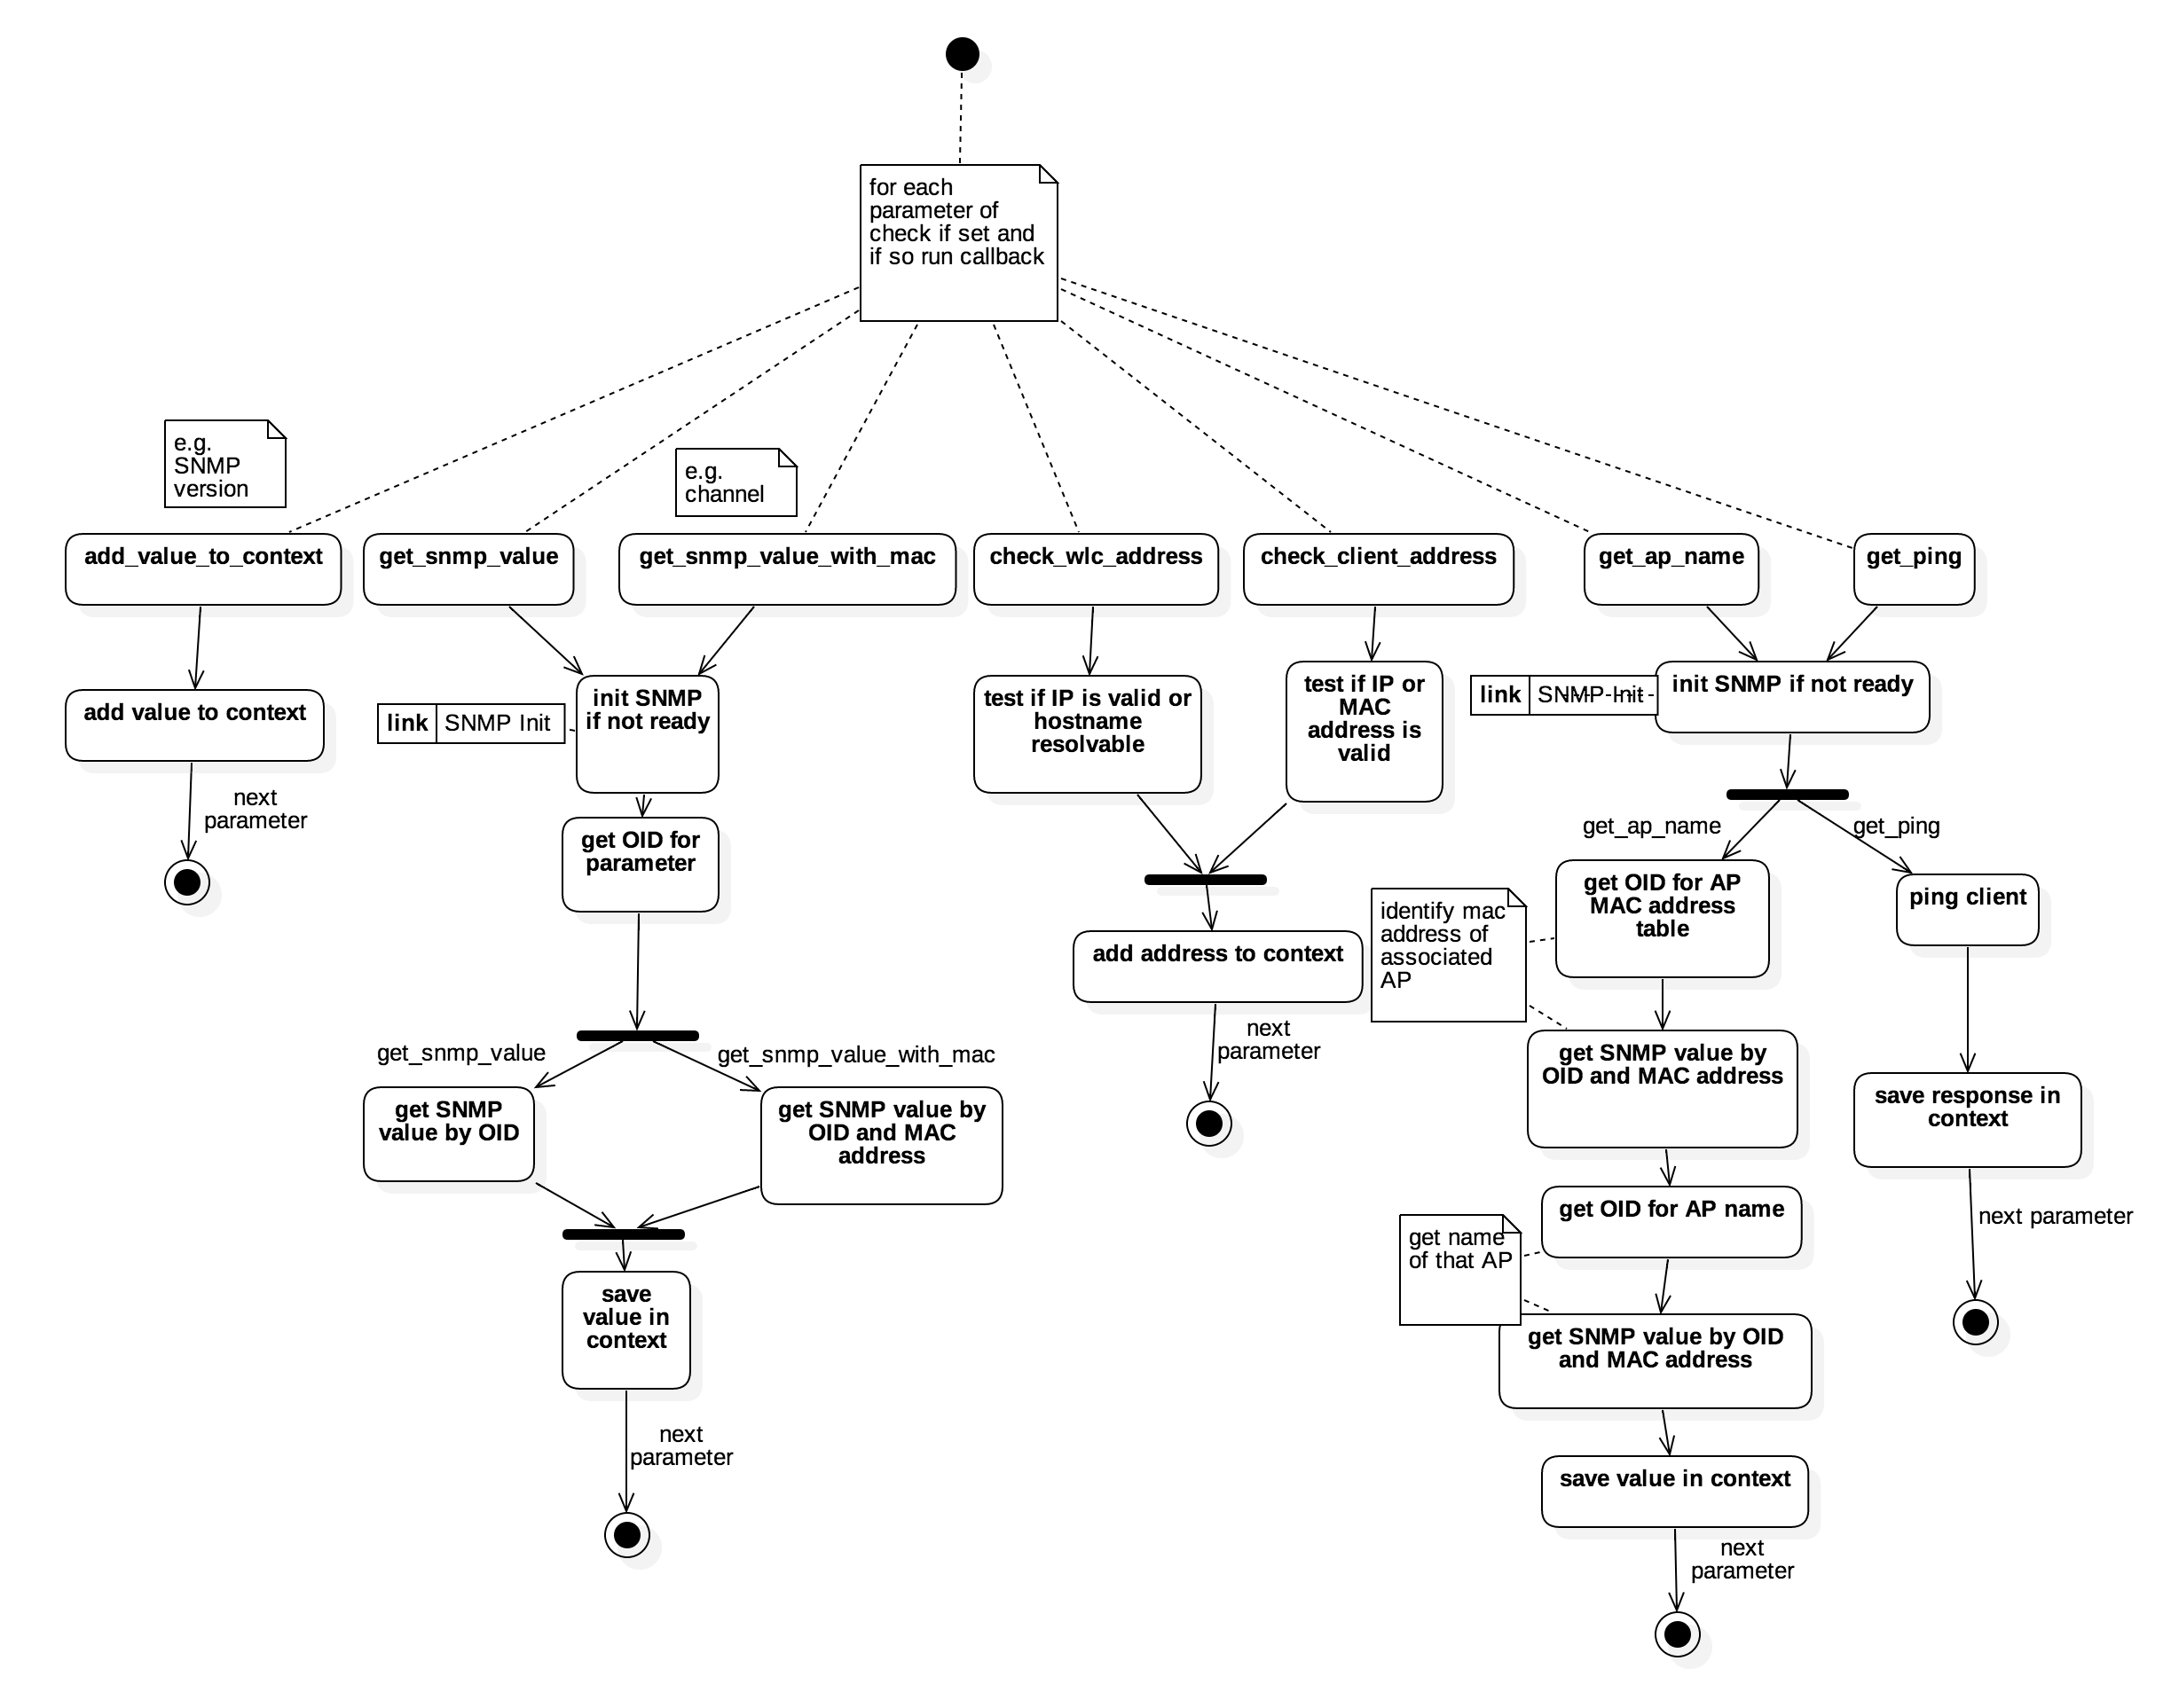
Commandline-Parsing sequence
Callback-Functions for reaction on command
Notes:
Viele vorgefertigte Funktionen, um eine einfache Erweiterbarkeit zu ermöglichen.

Slide 9
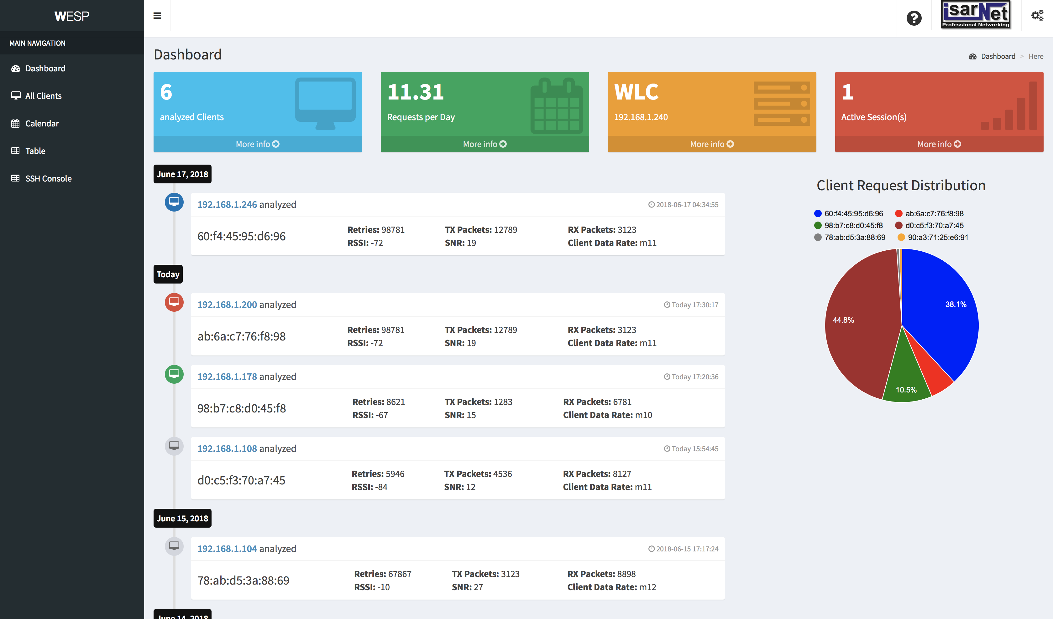
WESP-WEB
Web-Application for monitoring and evaluation
Client overview
Client-Monitor
Evaluation Charts
Live-Feed
Session-Calendar
WLC-Console via Web-SSH
Database Snapshot

Slide 10
RESULT
DEMO

Slide 12
Sources
Slide 2
Python-Logo: https://commons.wikimedia.org/wiki/File:Python-logo-notext.svg (16/06/2018)
SNMP-Logo: https://www.techcrumble.net/2018/03/how-to-configure-snmp-in-vcsa-6-5-snmpv1 (16/06/2018)
https://www.lifewire.com/cisco-support-2625661 (16/06/2018)
Slide 3
WLC2500erSeries-Picture: https://www.cisco.com/c/en/us/products/wireless/2500-series-wireless-controllers/index.html (16/06/2018)
MySQL-Logo: http://www.timtyson.us/archives/2014/05/05/mysql-database-test/ (16/06/2018)
Project-Architecture: IsarNet Project Document
Slide 4
Cisco-Object-Navigator Screenshots: http://snmp.cloudapps.cisco.com/Support/SNMP/do/BrowseOID.do?local=en (16/06/2018)

